Slide 1

English courses
Age 6–17
Learning Hub Parent and Guardian Guide
2024
www.britishcouncil.org

Slide 2
About this guide
Welcome to this introduction to the ‘new’ Learning Hub, where your child can improve their English online as part of their British Council course.
With the help of the learning hub your child will be able to:
do English activities
play educational games
participate in forums
share some of their work with you, because you will also have access to the platform
This guide will help you and your child to log in to the platform to benefit from this feature of the course.

Slide 3
The Learning Hub platform

Slide 4
How do I get my log-in details for me and my child?
Before your course starts you will receive a welcome message with your credentials, further steps and details about the course.

Slide 5
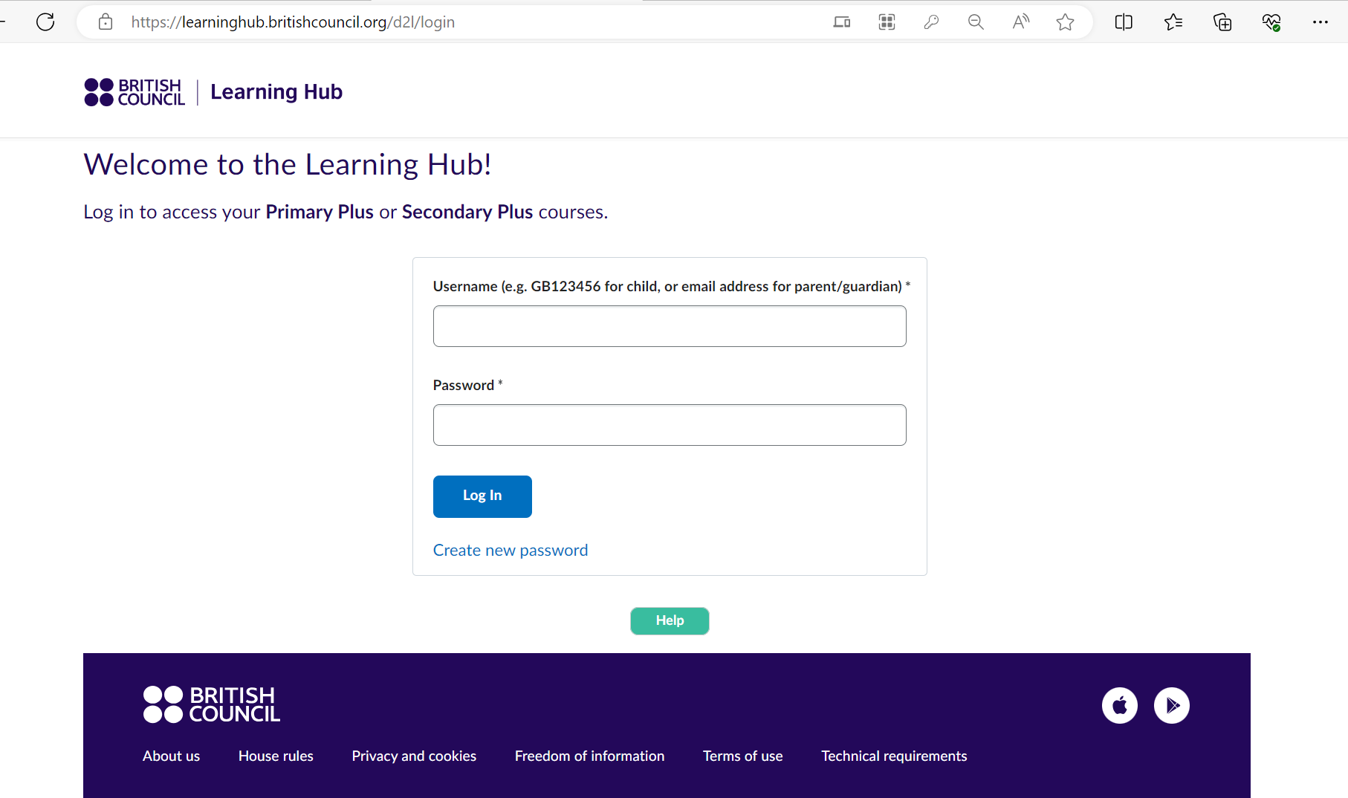
Where do my child and I log-in?
All students and guardians can log-in at the same address:
This is https://learninghub.britishcouncil.org/d2l/login
The first thing you need to do is to ‘create a new password’ by clicking here

Slide 6
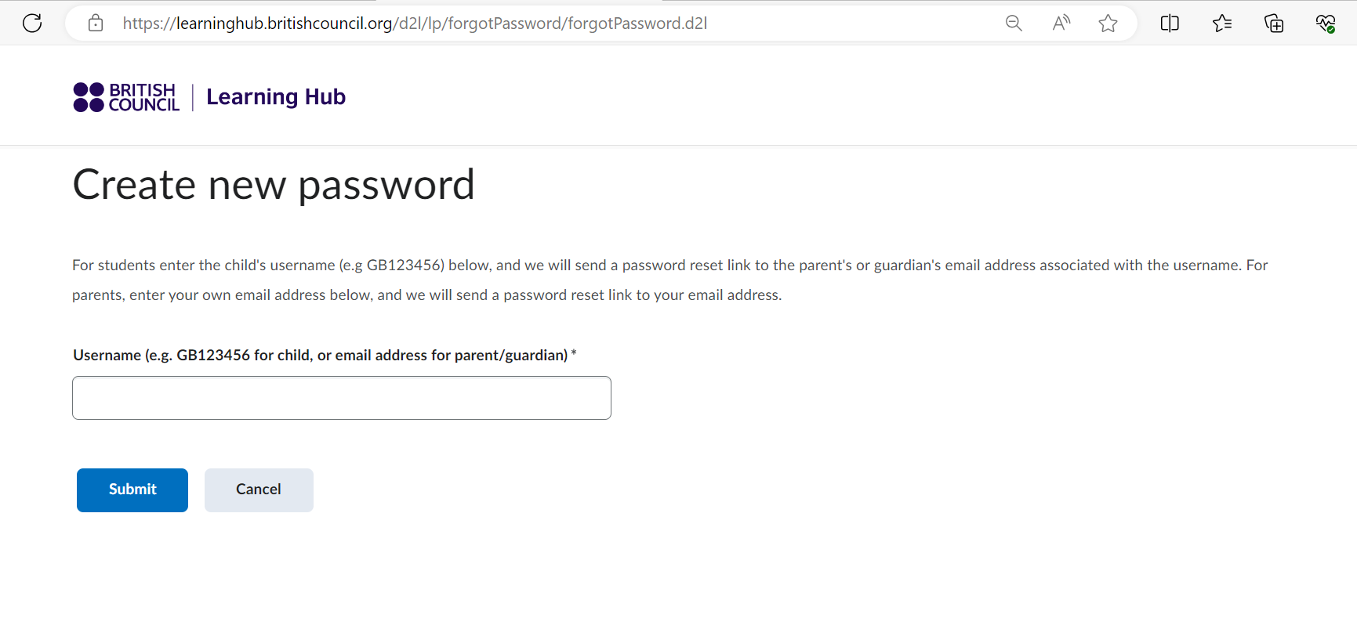
How do I create a new password?
To create a new password, put your username or the username of your child (these are in your welcome email). You will need to do this for each account. The press ‘submit’.

Slide 7
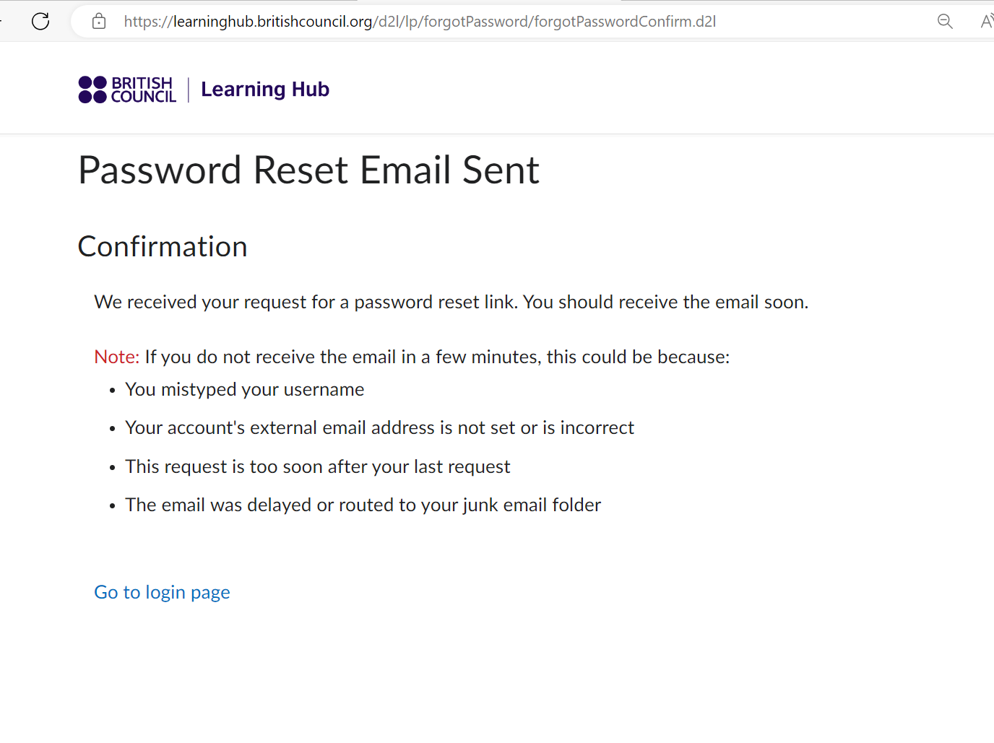
Where can I find my new password?
You will then see this message, which tells you the new password will be sent to your email address (it does not go to your child’s email).
Please remember that you need to do this for you and for each of your children.
If you forget your password, you can get a new one by following the same path that you used to ‘create a password’

Slide 8

How do my kids log in?
Please ensure your child knows their username and password.
They can go to https://learninghub.britishcouncil.org/d2l/login and sign in.

Slide 9
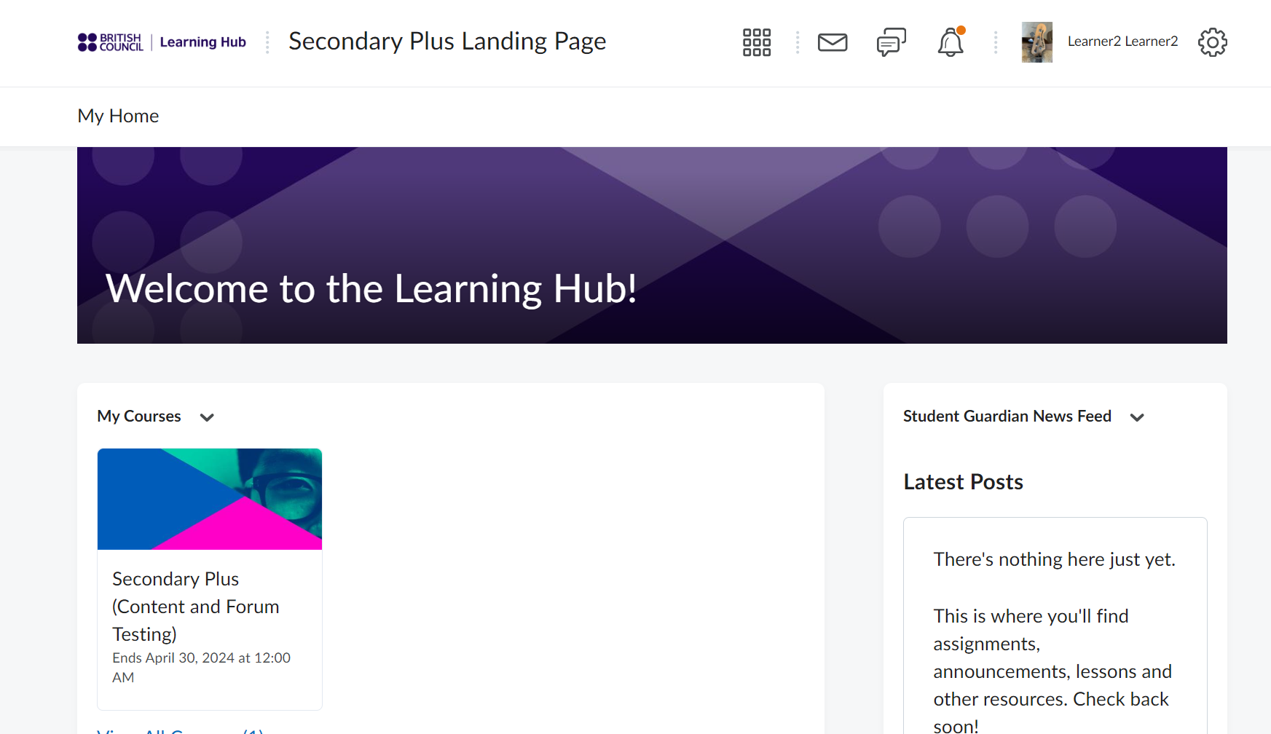
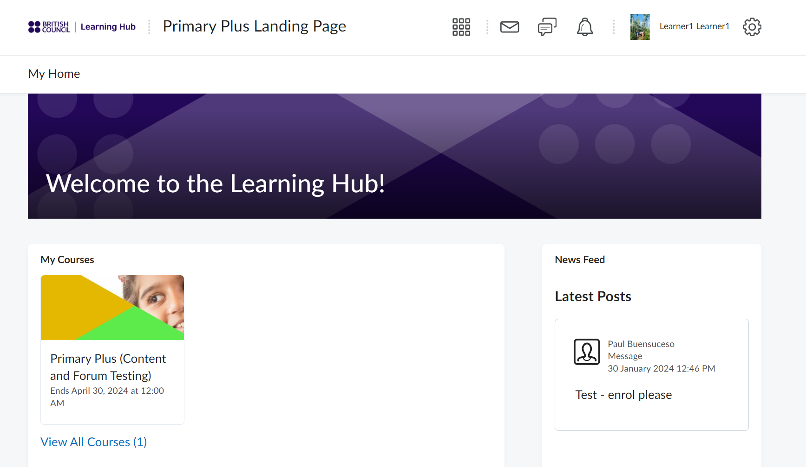
What does my child see?
Your child's course
Updates from the teaching centre

Slide 10
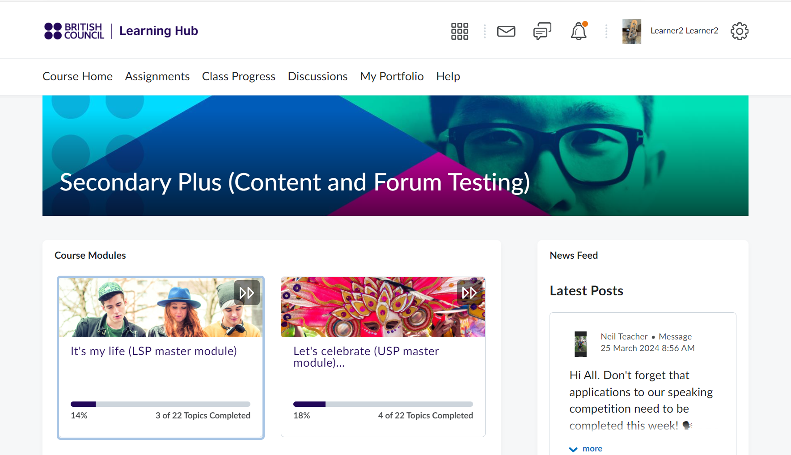
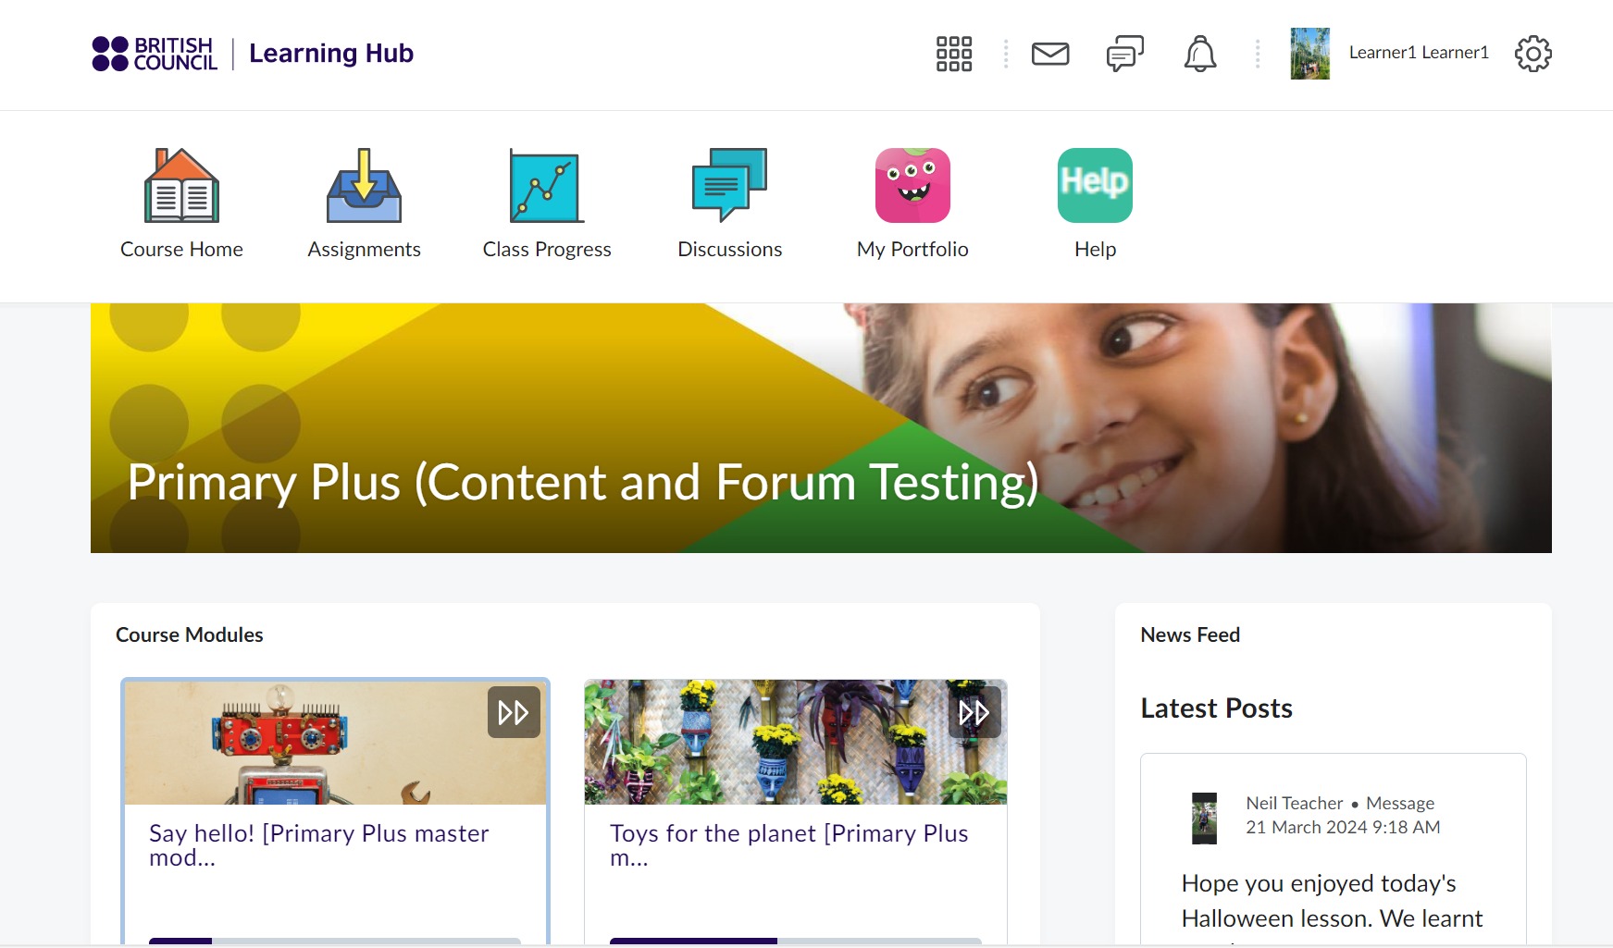
What can my child do?
Access assignment, progress, discussions and help
Access activities and educational games

Slide 11
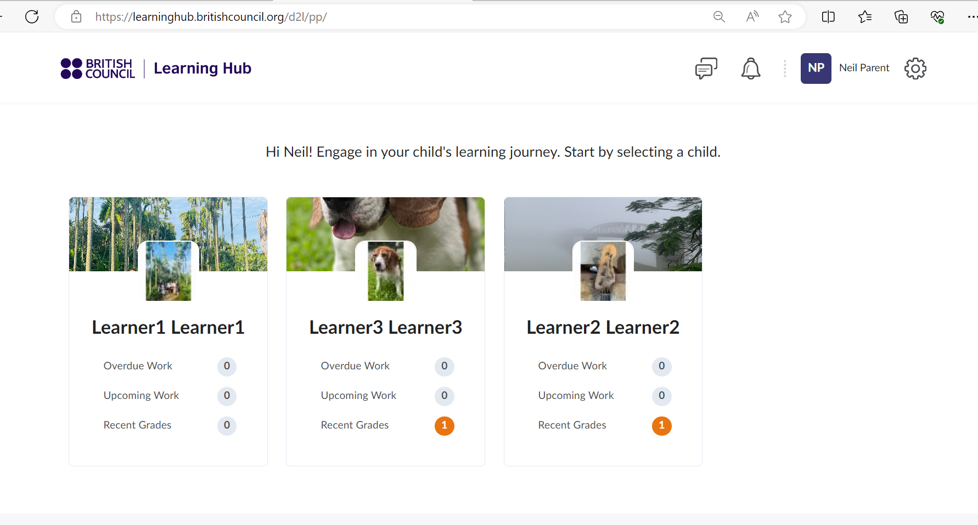
What can parents/guardians see in their account?
You will also get updates and notifications from the British Council.
When you log in you will see a panel for each of your children. Click on a child’s name to view more
Please note that course materials – magazines – are accessible only by students

Slide 12
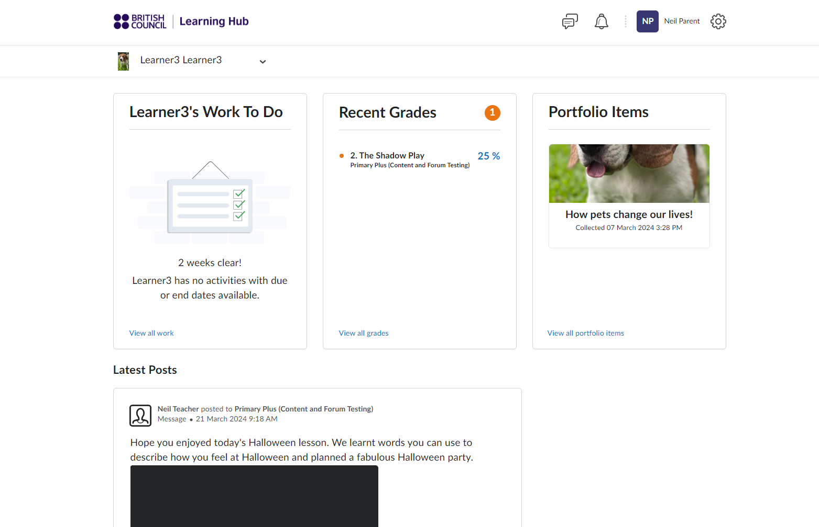
What can parents/guardians see in their account?
Any work to do before the next class
Your child’s completed work
Latest news

Slide 13

How can I ask for help?
For technical help, please press the ‘help’ button

Slide 14
The Learning Hub App

Slide 15
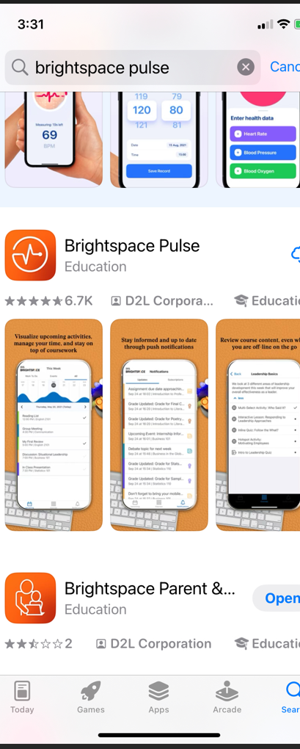
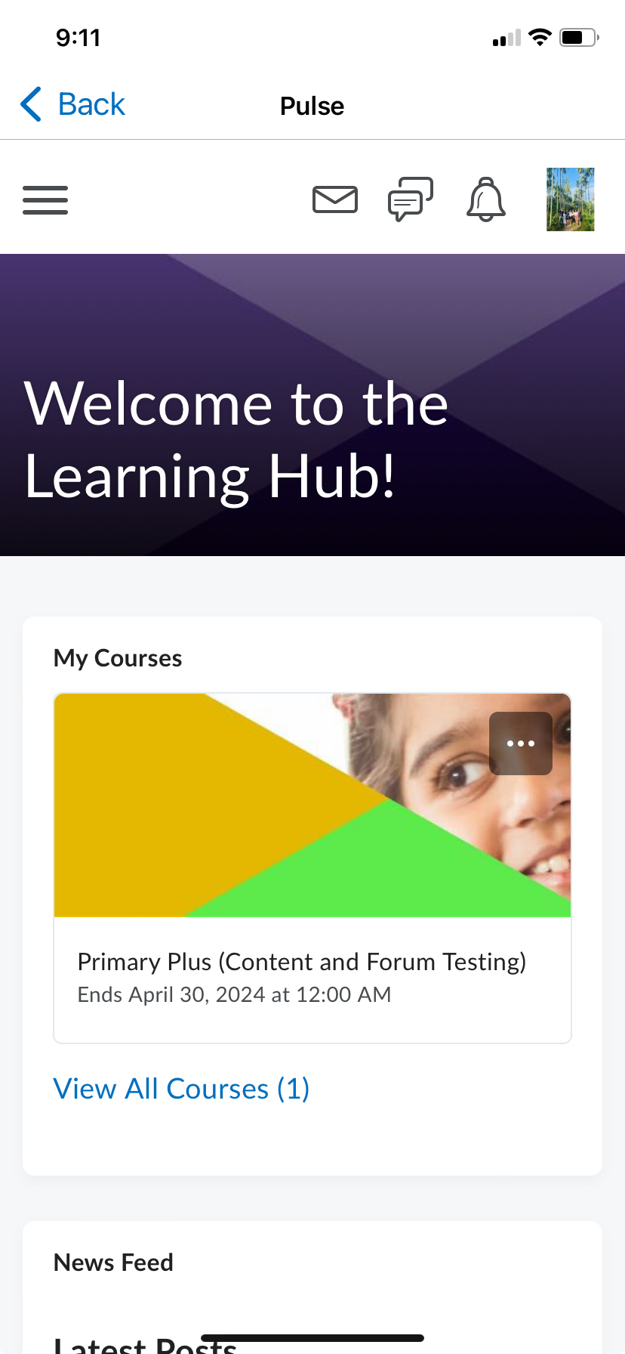
Can my child do this on their phone or tablet?
Simply download the app ‘Brightspace Pulse’ app from Play Store/ App Store to your child’s phone or tablet

Slide 16
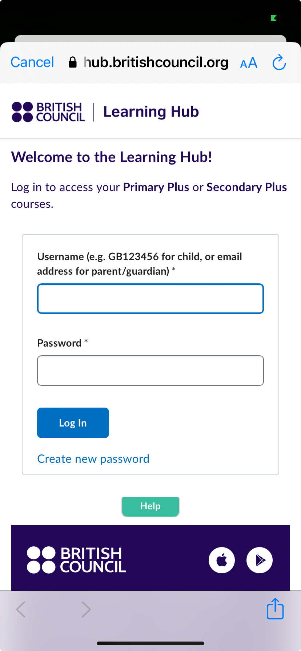
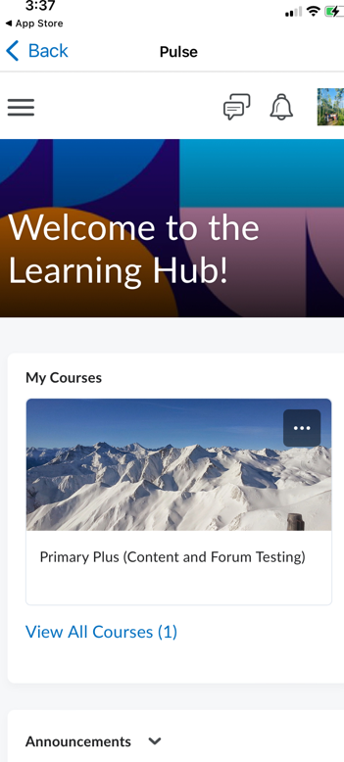
How does my child log into their account on the app?
Your child only needs to log in once, using the same username and password as the website
Once they have logged in the get full access to all of their online activities.

Slide 17
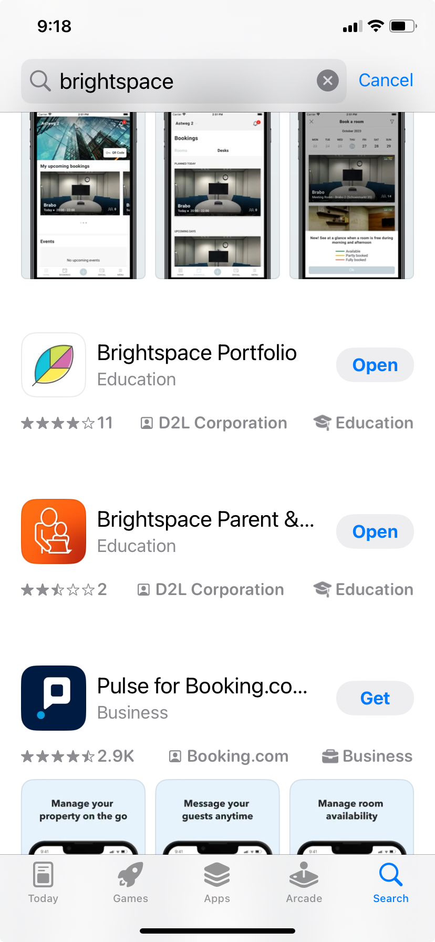
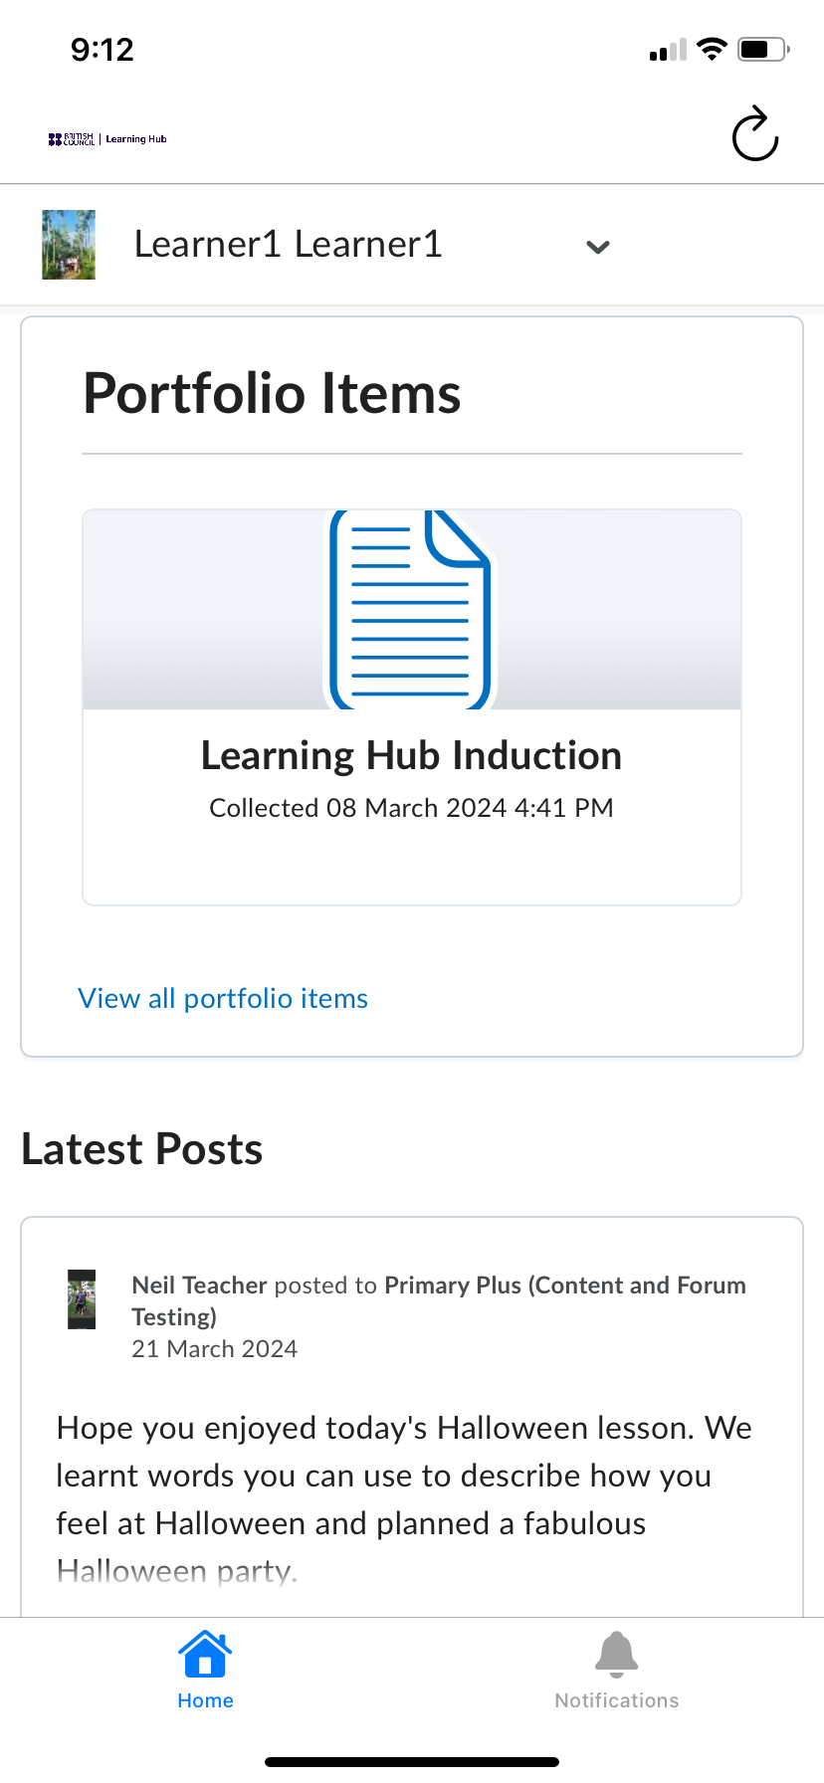
What about parents/ guardians?
Download the app ‘Brightspace Parent & Guardian Pulse’ app from Play Store/ App Store to your phone or tablet

Slide 18
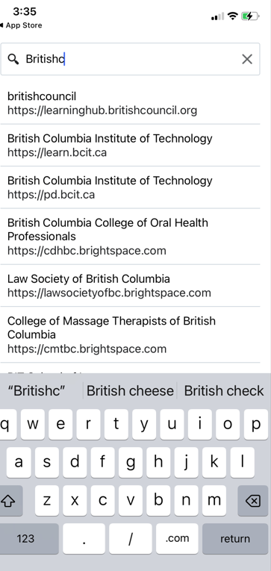
How can we find my child’s course on the app?
In the search box, type in Britishcouncil and then click on the https://learninghub.britishcouncil.org line.

