Slide 1

Teaching English in the Basic School: grades 5 - 9
New Ukrainian School
03 November 2021

Slide 2
Agenda
Core programme
Structure of the programme
Certificates
Requirements for teachers

Slide 3
Core Programme

Slide 4
Aim
Module 5
      improve skills of teaching English in the basic school
Outcomes
      deepen knowledge and understanding of the Ukrainian education reform concepts
      deepen awareness of the role of the teacher as the facilitator of learning
      consider the tools for further professional development through reflection on their own professional practices and cooperation with other teachers
      analyse and evaluate ways of developing learners' thinking skills and simulate situations that encourage deep learning and information processing, effective questioning and the use of core skills in learning a foreign language

Slide 5
Core programme
Introduction to the Programme
Understanding learners and their learning preferences
Managing the educational process
Assessment for learning
Developing communicative language skills
Teaching blueprint
Programme feedback and round-up conference

Slide 6
Programme components

Slide 7
Core programme
Components
Synchronous
Asynchronous
Live sessions
Forum discussions
Self-access modules
Portfolio

Slide 8
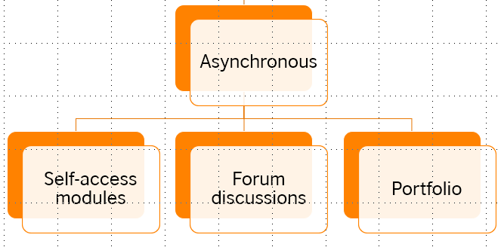



Components
The British Council OTC platform
Course content
Individual mode
Moderated
Forum guide
Tasks
Portfolio guide

Slide 9
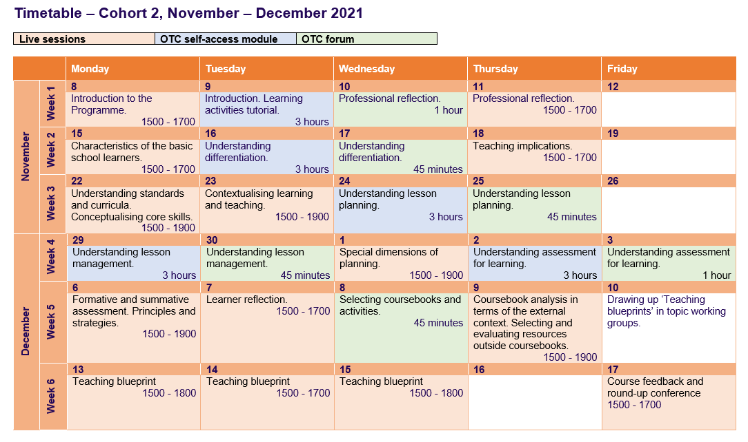

Slide 10
Course duration - 6 weeks
Total number of hours - 60
      Asynchronous online course and forums – 20 hours
      Synchronous live sessions – 40 hours

Slide 11
Certificates

Slide 12

To qualify for an INSETT certificate, you are expected to:
      complete 100% of the self-access course
      participate meaningfully in all forum discussions
      attend and fully engage in 100% of live sessions
      do all the portfolio tasks.
The course is recognised as part of teacher’s professional development

Slide 13
Requirements for teachers

Slide 14
Requirements for participants
      Willingness and commitment to professional development
      Level of English – B2
      Access to computers/notebooks
      Connection to the internet
      Time management

Slide 15



To register for the course:
      Welcome letter
      Participant’s Manual
      OTC and troubleshooting Guide

Slide 16
Thank you
Viktoriia.Ivanishcheva@britishcouncil.org.ua
myroslava.shlapak@britishcouncil.org

